Slide 1
Multi-table SQL Queries (Joins)
Reading: 13.3 – 13.5

Slide 2
13.3: Multi-table Queries
13.1: Database Basics
13.2: SQL
13.3: Multi-table Queries
13.4: Databases and PHP

Slide 3
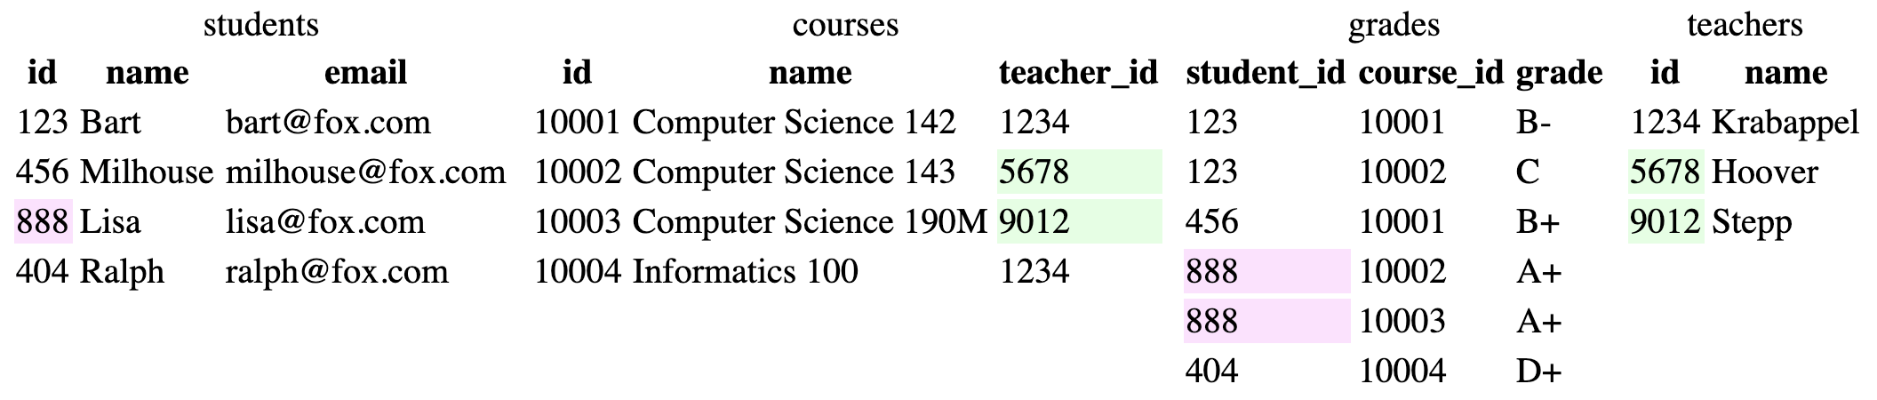
Related tables and keys
Notes:
Web Programming Step by Step, 2nd Edition Lecture 13: Relational Databases and SQL (webstepbook.com)

Slide 4
Related tables and keys
primary key: a column guaranteed to be unique for each record (e.g. Lisa Simpson's ID 888)
foreign key: a column in table A storing a primary key value from table B
(e.g. records in grades with student_id of 888 are Lisa's grades)
normalizing: splitting tables to improve structure / redundancy (linked by unique IDs)
Notes:
Web Programming Step by Step, 2nd Edition Lecture 14: Multi-table SQL Queries (Joins) (webstepbook.com)

Slide 5
Querying multi-table databases
When we have larger datasets spread across multiple tables, we need queries that can answer high-level questions such as:
What courses has Bart taken and gotten a B- or better?
What courses have been taken by both Bart and Lisa?
Who are all the teachers Bart has had?
How many total students has Ms. Krabappel taught, and what are their names?
To do this, we'll have to join data from several tables in our SQL queries.
Notes:
Web Programming Step by Step, 2nd Edition Lecture 14: Multi-table SQL Queries (Joins) (webstepbook.com)

Slide 6
Joining with ON clauses
join: combines records from two or more tables if they satisfy certain conditions
the ON clause specifies which records from each table are matched
the rows are often linked by their key columns (id)
Notes:
Web Programming Step by Step, 2nd Edition Lecture 14: Multi-table SQL Queries (Joins) (webstepbook.com)

Slide 7
Joining with ON clauses
SELECT column(s)
FROM table1
JOIN table2 ON condition(s)
...
JOIN tableN ON condition(s);
SELECT *
FROM students
JOIN grades ON id = student_id;
Notes:
Web Programming Step by Step, 2nd Edition Lecture 14: Multi-table SQL Queries (Joins) (webstepbook.com)

Slide 8
Join example
SELECT *
FROM students
JOIN grades ON id = student_id;
id | name | email | student_id | course_id | grade
123 | Bart | bart@fox.com | 123 | 10001 | B-
123 | Bart | bart@fox.com | 123 | 10002 | C
404 | Ralph | ralph@fox.com | 404 | 10004 | D+
456 | Milhouse | milhouse@fox.com | 456 | 10001 | B+
888 | Lisa | lisa@fox.com | 888 | 10002 | A+
888 | Lisa | lisa@fox.com | 888 | 10003 | A+
Notes:
Web Programming Step by Step, 2nd Edition Lecture 14: Multi-table SQL Queries (Joins) (webstepbook.com)

Slide 9
Join example
table.column can be used to disambiguate column names:
SELECT *
FROM students
JOIN grades ON students.id = grades.student_id;
Notes:
Web Programming Step by Step, 2nd Edition Lecture 14: Multi-table SQL Queries (Joins) (webstepbook.com)

Slide 10
Filtering columns in a join
SELECT name, course_id, grade
FROM students
JOIN grades ON id = student_id;
name | course_id | grade
Bart | 10001 | B-
Bart | 10002 | C
Ralph | 10004 | D+
Milhouse | 10001 | B+
Lisa | 10002 | A+
Lisa | 10003 | A+
Notes:
Web Programming Step by Step, 2nd Edition Lecture 14: Multi-table SQL Queries (Joins) (webstepbook.com)

Slide 11
Filtered join (JOIN with WHERE)
SELECT name, course_id, grade
FROM students
JOIN grades ON id = student_id
WHERE name = 'Bart';
name | course_id | grade
Bart | 10001 | B-
Bart | 10002 | C
Notes:
Web Programming Step by Step, 2nd Edition Lecture 14: Multi-table SQL Queries (Joins) (webstepbook.com)

Slide 12
Filtered join (JOIN with WHERE)
SELECT name, course_id, grade
FROM students
JOIN grades ON id = student_id
WHERE name = 'Bart';
FROM / JOIN glue the proper tables together, and WHERE filters the results
What goes in the ON clause, and what goes in WHERE?
ON directly links columns of the joined tables
WHERE sets additional constraints such as particular values (123, 'Bart')
Notes:
Web Programming Step by Step, 2nd Edition Lecture 14: Multi-table SQL Queries (Joins) (webstepbook.com)

Slide 13
What's wrong with this?
SELECT name, id, course_id, grade
FROM students
JOIN grades ON id = 123
WHERE id = student_id;
name id course_id grade
Bart 123 10001 B-
Bart 123 10002 C
The above query produces the same rows as the previous one, but it is poor style. Why?
Notes:
Web Programming Step by Step, 2nd Edition Lecture 14: Multi-table SQL Queries (Joins) (webstepbook.com)

Slide 14
What's wrong with this?
SELECT name, id, course_id, grade
FROM students
JOIN grades ON id = 123
WHERE id = student_id;
The JOIN ON clause is poorly chosen. It doesn't really say what connects a grades record to a students record.
They are related when they are for a student with the same id.
Filtering out by a specific ID or name should be done in the WHERE clause, not JOIN ON.
Notes:
Web Programming Step by Step, 2nd Edition Lecture 14: Multi-table SQL Queries (Joins) (webstepbook.com)

Slide 15
Giving names to tables
SELECT s.name, g.*
FROM students s
JOIN grades g ON s.id = g.student_id
WHERE g.grade <= 'C';
can give names to tables, like a variable name in Java
to specify all columns from a table, write table.*
(grade column sorts alphabetically, so grades C or better are ones <= it)
Notes:
Web Programming Step by Step, 2nd Edition Lecture 14: Multi-table SQL Queries (Joins) (webstepbook.com)

Slide 16
Giving names to tables
SELECT s.name, g.*
FROM students s
JOIN grades g ON s.id = g.student_id
WHERE g.grade <= 'C';
name | student_id | course_id | grade
Bart | 123 | 10001 | B-
Bart | 123 | 10002 | C
Milhouse | 456 | 10001 | B+
Lisa | 888 | 10002 | A+
Lisa | 888 | 10003 | A+
Notes:
Web Programming Step by Step, 2nd Edition Lecture 14: Multi-table SQL Queries (Joins) (webstepbook.com)

Slide 17
Multi-way join
Name
Computer Science 142
SELECT c.name
FROM courses c
JOIN grades g ON g.course_id = c.id
JOIN students bart ON g.student_id = bart.id
WHERE bart.name = 'Bart' AND g.grade <= 'B-';
More than 2 tables can be joined, as shown above
What does the above query represent?
The names of all courses in which Bart has gotten a B- or better.
Notes:
Web Programming Step by Step, 2nd Edition Lecture 14: Multi-table SQL Queries (Joins) (webstepbook.com)

Slide 18
A suboptimal query
Exercise: What courses have been taken by both Bart and Lisa?
SELECT bart.course_id
FROM grades bart
JOIN grades lisa ON lisa.course_id = bart.course_id
WHERE bart.student_id = 123
AND lisa.student_id = 888;
Problem: requires us to know Bart/Lisa's Student IDs, and only spits back course IDs, not names.
Write a version of this query that gets us the course names, and only requires us to know Bart/Lisa's names, not their IDs.
Notes:
Web Programming Step by Step, 2nd Edition Lecture 14: Multi-table SQL Queries (Joins) (webstepbook.com)

Slide 19
Improved query
Exercise: What courses have been taken by both Bart and Lisa?
SELECT DISTINCT c.name
FROM courses c
JOIN grades g1 ON g1.course_id = c.id
JOIN students bart ON g1.student_id = bart.id
JOIN grades g2 ON g2.course_id = c.id
JOIN students lisa ON g2.student_id = lisa.id
WHERE bart.name = 'Bart'
AND lisa.name = 'Lisa';
Notes:
Web Programming Step by Step, 2nd Edition Lecture 14: Multi-table SQL Queries (Joins) (webstepbook.com)

Slide 20
Practice queries
What are the names of all teachers Bart has had?
SELECT DISTINCT t.name
FROM teachers t
JOIN courses c ON c.teacher_id = t.id
JOIN grades g ON g.course_id = c.id
JOIN students s ON s.id = g.student_id
WHERE s.name = 'Bart';
Notes:
Web Programming Step by Step, 2nd Edition Lecture 14: Multi-table SQL Queries (Joins) (webstepbook.com)

Slide 21
Practice queries
How many total students has Ms. Krabappel taught, and what are their names?
SELECT DISTINCT s.name
FROM students s
JOIN grades g ON s.id = g.student_id
JOIN courses c ON g.course_id = c.id
JOIN teachers t ON t.id = c.teacher_id
WHERE t.name = 'Krabappel';
Notes:
Web Programming Step by Step, 2nd Edition Lecture 14: Multi-table SQL Queries (Joins) (webstepbook.com)

Slide 22
Designing a query
Figure out the proper SQL queries in the following way:
Which table(s) contain the critical data? (FROM)
Which columns do I need in the result set? (SELECT)
How are tables connected (JOIN) and values filtered (WHERE)?
Test on a small data set (imdb_small).
Confirm on the real data set (imdb).
Try out the queries first in the MySQL console.
Write the PHP code to run those same queries.
Make sure to check for SQL errors at every step!!
Notes:
Web Programming Step by Step, 2nd Edition Lecture 14: Multi-table SQL Queries (Joins) (webstepbook.com)

Slide 23
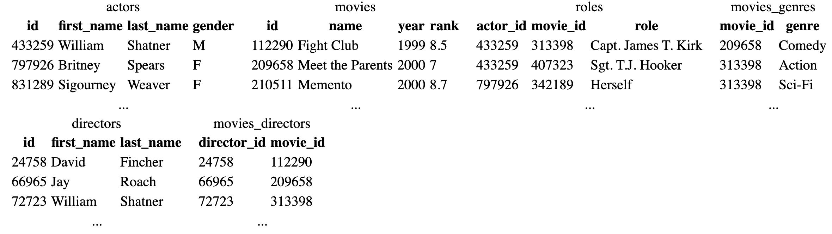
Example imdb database
also available, imdb_small with fewer records (for testing queries)
Notes:
Web Programming Step by Step, 2nd Edition Lecture 14: Multi-table SQL Queries (Joins) (webstepbook.com)

Slide 24
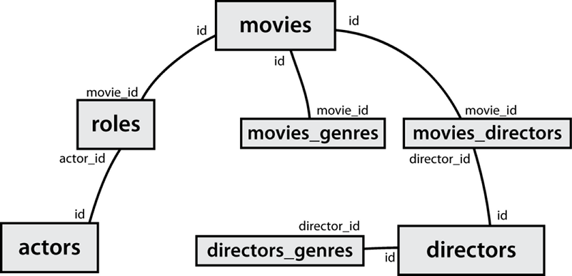
IMDb table relationships / ids
Notes:
Web Programming Step by Step, 2nd Edition Lecture 14: Multi-table SQL Queries (Joins) (webstepbook.com)

Slide 25
IMDb query example
[stepp@webster ~]$ mysql -u myusername -p
Enter password:
Welcome to the MySQL monitor. Commands end with ; or \g.
mysql> use imdb_small;
Database changed
mysql> select * from actors where first_name like '%mick%';
Notes:
Web Programming Step by Step, 2nd Edition Lecture 14: Multi-table SQL Queries (Joins) (webstepbook.com)

Slide 26
IMDb query example
mysql> select * from actors where first_name like '%mick%';
+--------+------------+-----------+--------+------------+
| id | first_name | last_name | gender | film_count |
+--------+------------+-----------+--------+------------+
| 71699 | Mickey | Cantwell | M | 1 |
| 115652 | Mickey | Dee | M | 1 |
| 470693 | Mick | Theo | M | 1 |
| 716748 | Mickie | McGowan | F | 1 |
+--------+------------+-----------+--------+------------+
4 rows in set (0.056 sec)
Notes:
Web Programming Step by Step, 2nd Edition Lecture 14: Multi-table SQL Queries (Joins) (webstepbook.com)

Slide 27
IMDb practice queries
What are the names of all movies released in 1995?
How many people played a part in the movie "Lost in Translation"?
What are the names of all the people who played a part in the movie "Lost in Translation"?
Who directed the movie "Fight Club"?
How many movies has Clint Eastwood directed?
What are the names of all movies Clint Eastwood has directed?
Notes:
Web Programming Step by Step, 2nd Edition Lecture 14: Multi-table SQL Queries (Joins) (webstepbook.com)

Slide 28
IMDb practice queries
What are the names of all directors who have directed at least one horror film?
What are the names of every actor who has appeared in a movie directed by Christopher Nolan?
Notes:
Web Programming Step by Step, 2nd Edition Lecture 14: Multi-table SQL Queries (Joins) (webstepbook.com)

